Slide 1
LZ1 Sequential Implementation
Presenters:
Rahul Mittal
Neel Prajapati

Slide 2
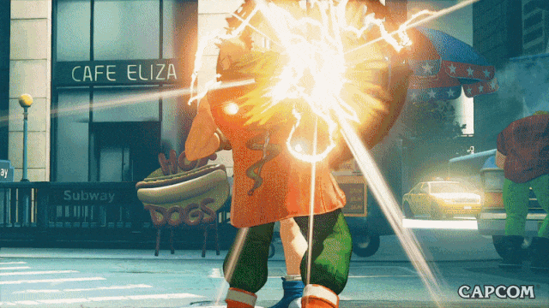




Slide 3
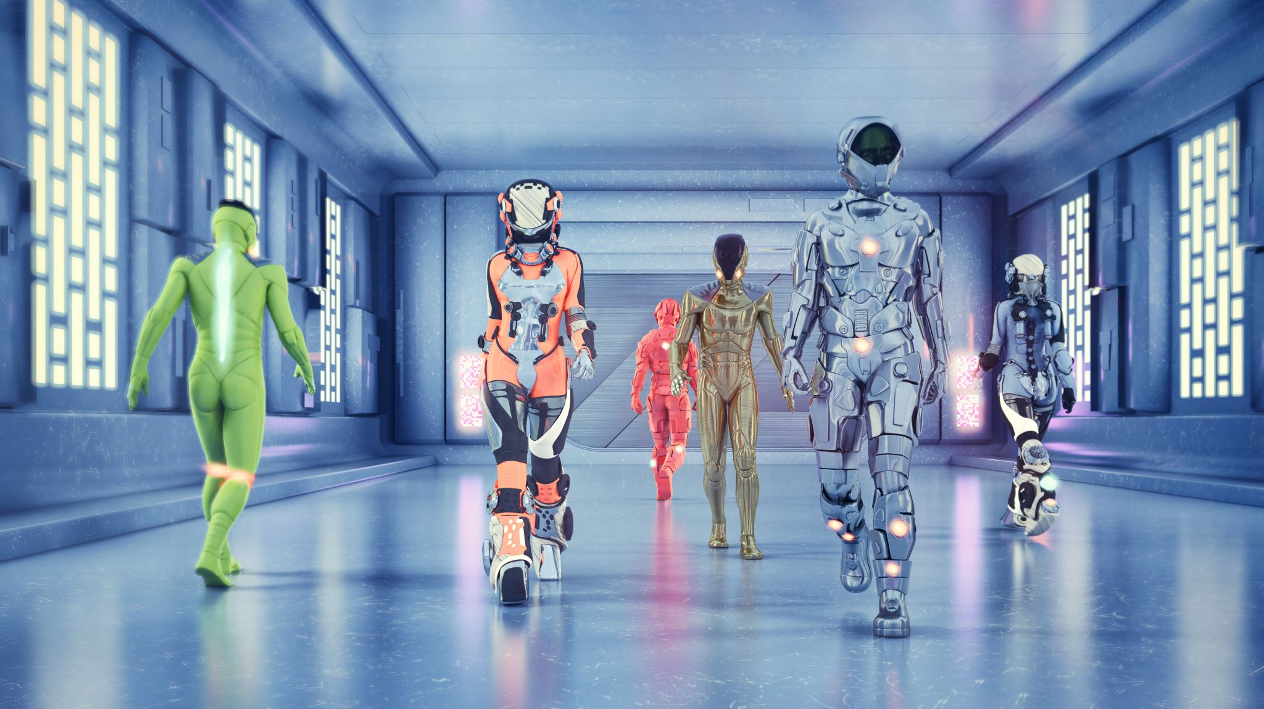
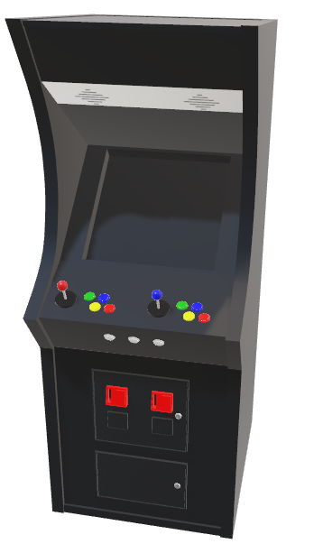
In the early days of video gaming, fitting large games onto a single storage media was a challenge, making games expensive and limiting accessibility. But Capcom, the creators of Street Fighter 2, found an innovative solution - data compression.
Capcom analysed and compressed the game's graphics, sound effects, and other data using an algorithm with a unique ability to recognize repeating patterns in the data, resulting in a visually stunning game that could fit on a single storage media, making it accessible to a wider audience.
The algorithm used was LZ1, named after its inventors Lempel and Ziv. In this presentation, we will explore the mechanics of LZ1 and its use in compressing text files

Slide 4
Data Compression?
Data compression is the process of reducing the size of a computer file. Through an algorithm or a set of rules for carrying out an operation, computers can determine ways to shorten long strings of data and later reassemble them in a recognizable form upon retrieval.

Slide 5


Basic Model for Data Compression
a2b3c2d1
aabbbccd
aabbbccd
Compress
Expand

Slide 6
Data Has Repetitions!
Data compression algorithms save space by exploiting the fact that most data files have many repeating patterns in them.
For example, text data has certain character sequences that appear much more often than others

Slide 7
Repetitions Are Beneficial
Identifying repeating patterns makes it possible to represent them using less space.
One approch to identification and space saving is to point to past occurrence of the pattern.
LZ1 algorithm, that is the topic of this presentation, is one of the members of a well know family of algorithms that uses adaptive dictionaries as the reference mechanism to point to past occurrences.

Slide 8
LZ1 Algorithm
while (input is not empty)
{
get a reference (position, length) to longest match;
if (length > 0)
{
output (position, length, next symbol);
shift the window length+1 positions along;
}else {
output (0, 0, first symbol in the lookahead buffer);
shift the window 1 character along;
}
}

Slide 9
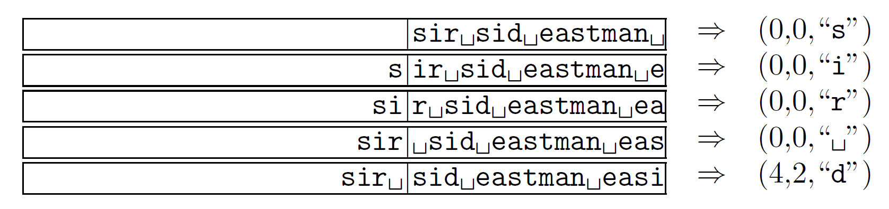
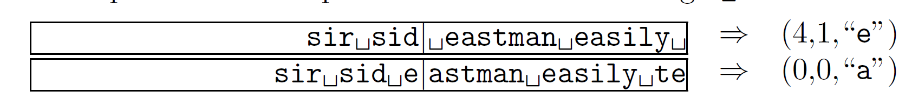
Compression Example
Source: Data Compression-The Complete Reference

Slide 10
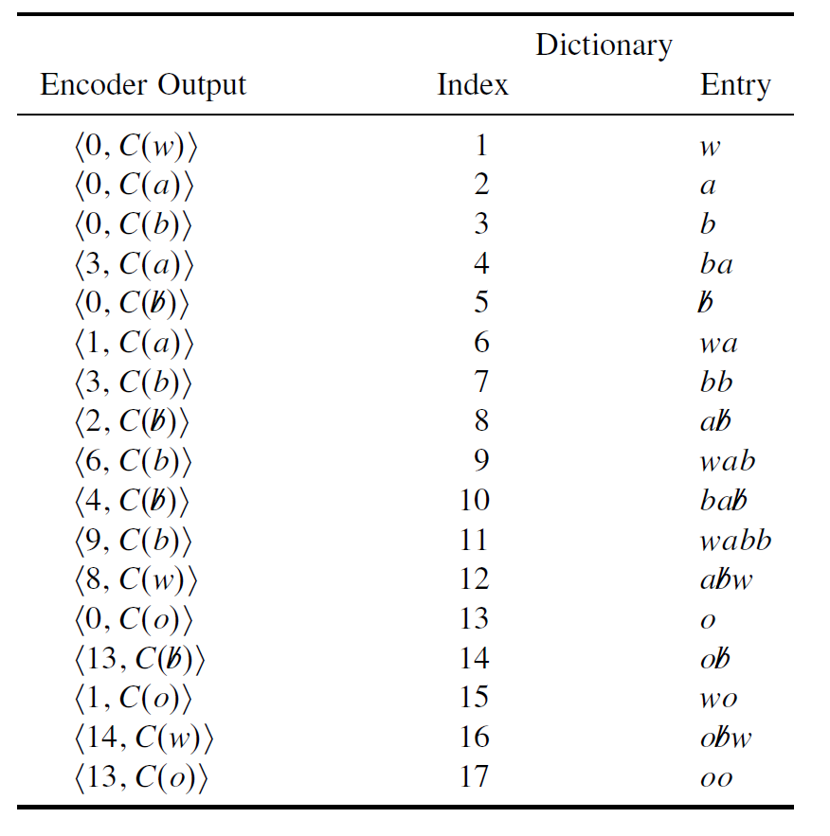
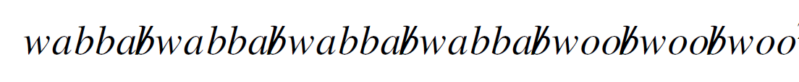
An Advantage of Sliding Window
As the search window contains characters that are directly preceding the current characters being compressed, patterns repeating in only certain parts of the input are captured efficiently and effectively.
(Source: Introduction to Data Compression)

Slide 11
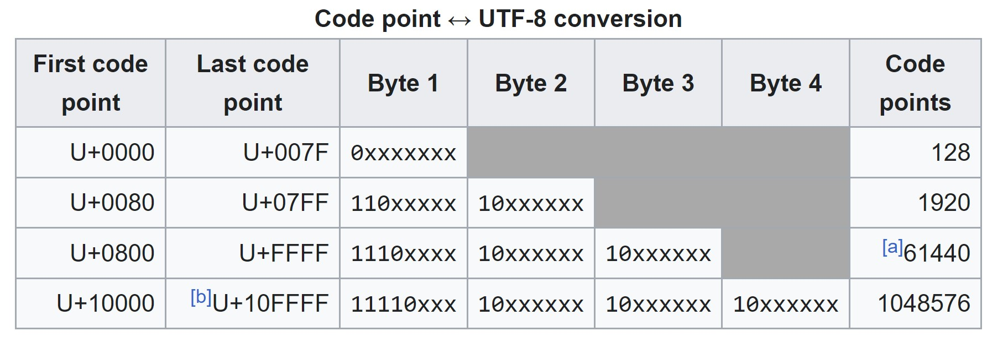
UTF-8 Representation
SPACE SAVER BECAME A NIGHTMARE
Source: Wikipedia

Slide 12
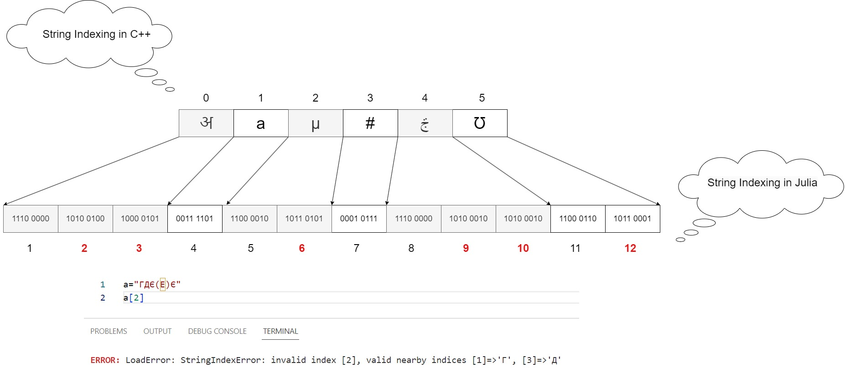
Challenges Faced
Julia String Indices are mapped to bytes.

Slide 13
CODE COMPARISON
Restricted to ASCII in UTF-8
For Unicode

Slide 14
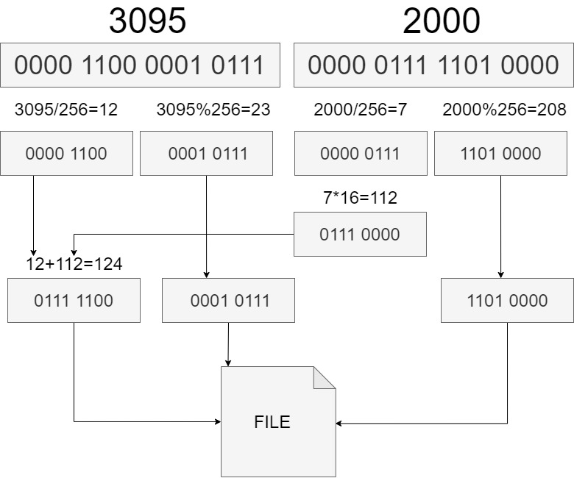
Avoiding wastage of Space

Slide 15
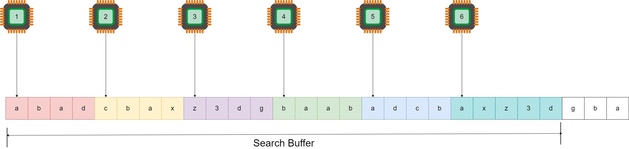
Potential Opportunities for Parallel Implementations
Parallelizing the search phase on CPU:

Slide 16
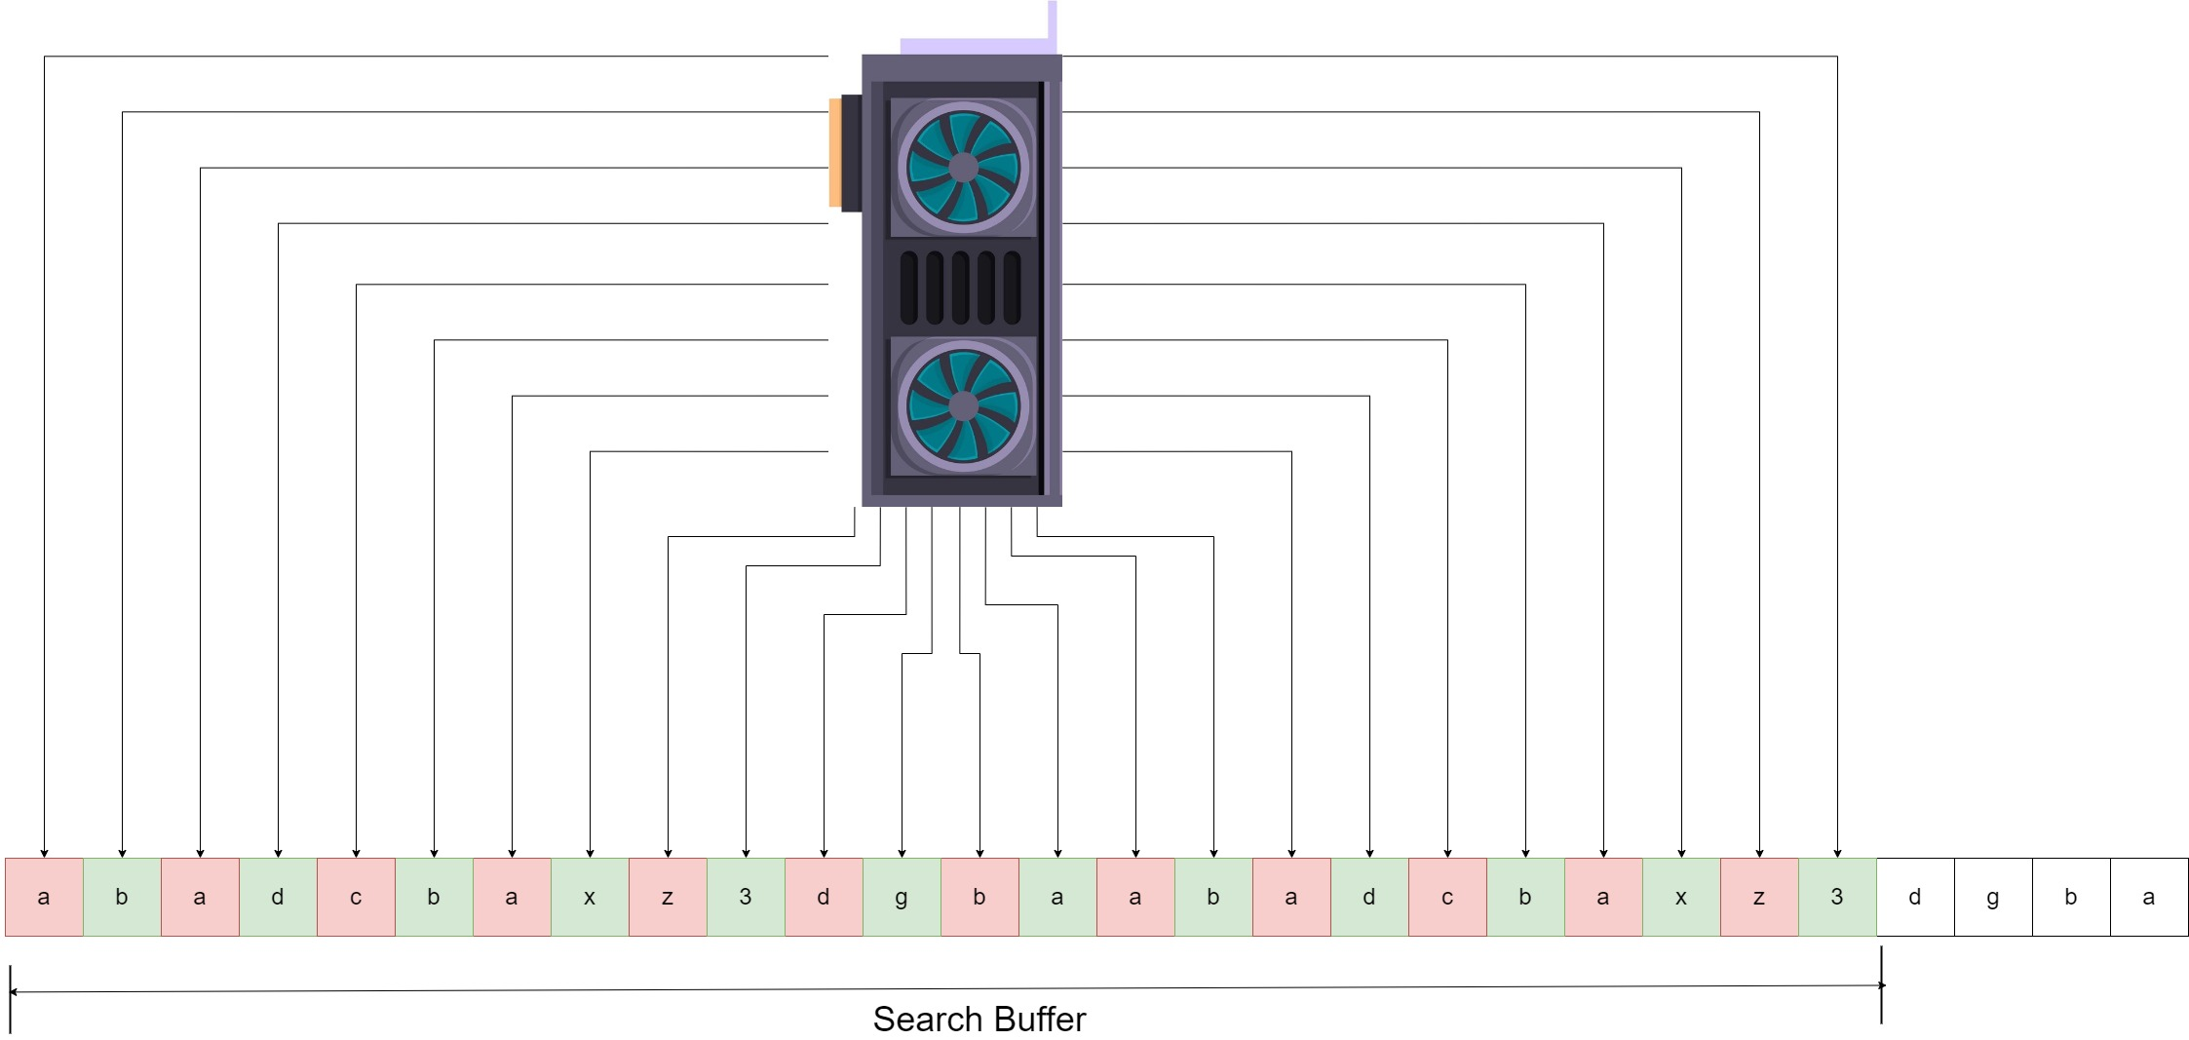
2. Parallelizing the search phase on GPU:

Slide 17
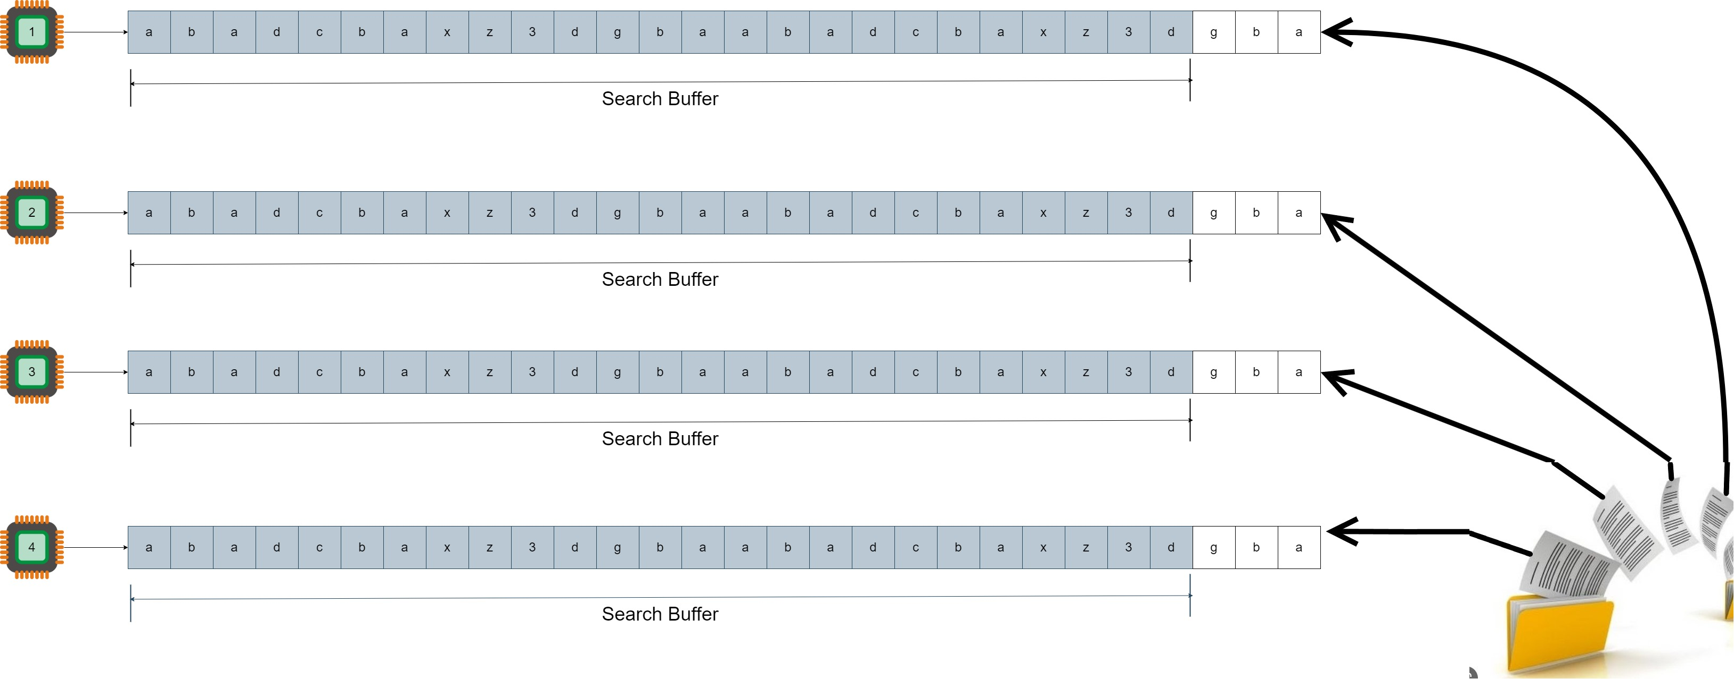
3. Dividing the File and Compressing in Parallel

